Slide 1
CS676 Final Presentation
By: Paul Tuccinardi

Slide 2
Project Idea
Create a way to compare different clustering algorithms
Goal is to compare K-means, K-medians and K-medoids algorithms
Method to compare
  Create dataset and find the optimal value for k
  Create the clusterings for each of the methods and graph
  Find a way to outline cluster area
  Find area of clusters
  Find way to compare the areas of various clusters and where they overlap

Slide 3
Project Idea
For this project to work a few things need to be defined
Dataset needs to be the same for all clustering algorithms
Center points/ medoid points need to be the same
Area of cluster needs to be defined for certain criterias
  If there is one point the area is 0
  If there are 2 points, create a circle surrounding them
  If there are 3 points or more, find the area.

Slide 4
Tools used
Utilized matplotlib to create appropriate graphs
sklearn to create k-means and k-medoids
Used pyclustering to create k-medians clustering
Used Polygon import to calculate area of cluster
Use math import to calculate distance for radius of circle

Slide 5
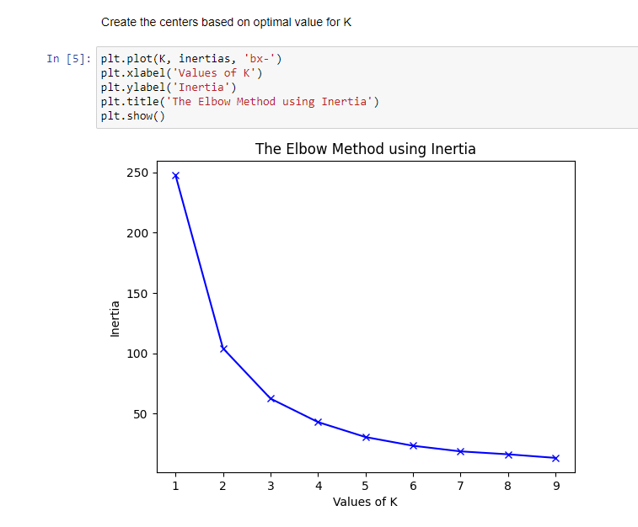

Slide 6
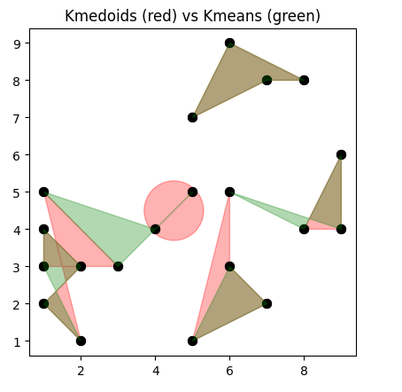
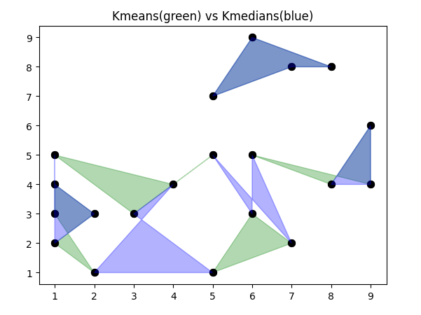
Results

Slide 7
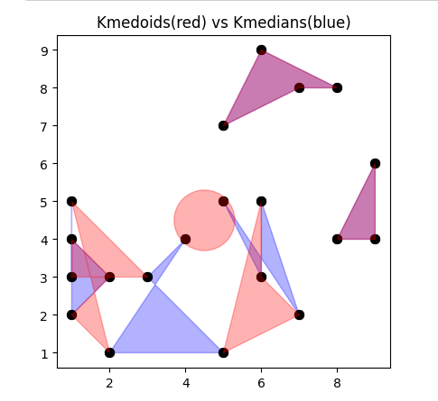
Results
K-medoids | area
0 | 1.571
1 | 2
2 | 1
3 | 2.5
4 | 1.5
K-means | area
0 | 0.5
1 | 2
2 | 2
3 | 1.5
4 | 0.5
K-medians | area
0 | 2.5
1 | 2
2 | 1
3 | 0.5
4 | 1

Slide 8
Results
Some clusters contained the same area between the various methods
All area ranges are between 0.5 and 2.5
Overall each clustering method produced slightly different clusterings with different resulting areas for the same dataset

Slide 9
Questions?

